Slide 1
AWS PrivateLink

Slide 2
Agenda
What AWS Private Link is?
Benefits of using AWS Private Link.
Use cases of AWS Private Link.

Slide 3

AWS PrivateLink
Private communication between
VPCs,
AWS services, and
On-premises networks.
Connect services across accounts and VPCs.
Interface VPC endpoints and Load balancer VPC endpoints.
Does not leave the Amazon network.

Slide 4
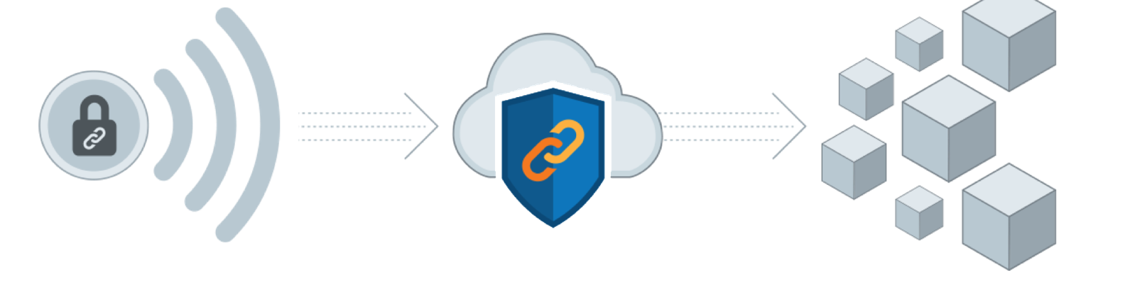
Benefits of using PrivateLink
Ensure safety of traffic.
Connect our VPCs to AWS services.
Does not pass over the public internet.
Less vulnerable to attacks.
Hosted on our own private network.
Associate security groups with interface endpoints.

Slide 5
Benefits of using PrivateLink
Network Management:
No requirement of firewall rules.
Path definitions.
Route tables.
No need to set up an Internet gateway.
Establish a VPC peering connection.

Slide 6
Benefits of using PrivateLink
Administer VPC Classless Inter-Domain Routing.
Easier to manage global network,
Simplifies your network design.

Slide 7
Benefits of using PrivateLink
Cloud Migration:
Our data isn't accessible to the Internet,
Could be hacked.
Relocate and use more cloud services,
Our traffic is safe.
Exposing our sensitive information.

Slide 8
PrivateLink Usecases
Securely access SaaS applications:
SaaS services to their customers.
SaaS vendors place agents or clients.
Generate and deliver data back to them.
Customers must choose between permitting Internet access.

Slide 9
PrivateLink Usecases
Regulatory Compliance:
Preventing sensitive data from travelling.
Stay in compliance with rules like
HIPAA,
EU/US Privacy Shield, and
PCI.

Slide 10
PrivateLink Usecases
PrivateLink keeps traffic between
AWS resources,
VPCs, and
Third-party services on the Amazon network.
Strict security and compliance restrictions.

Slide 11

PrivateLink Usecases
Move to a Hybrid Cloud:
On-premises applications can connect to service endpoints.
Directed to AWS services via AWS PrivateLink.
Allows SaaS companies to deliver services.
They were hosted on a private network.

